Slide 1
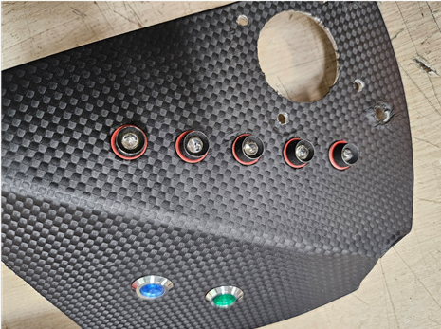
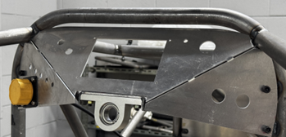
IMD
LED
RTD ON

Slide 2
BSPD
LED
BMS
LED 1,2

Slide 3
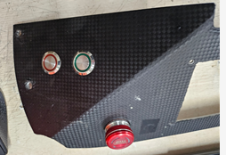
RTD ON
SWITCH

Slide 4
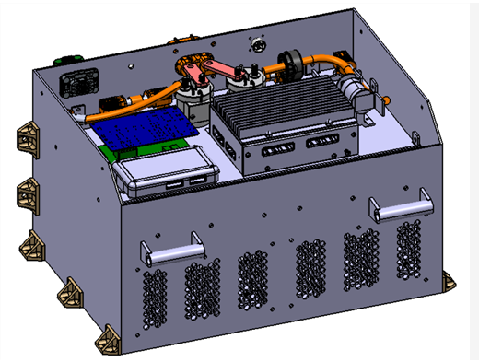
IMD
TSAL

Slide 5
초기충전회로

Slide 6
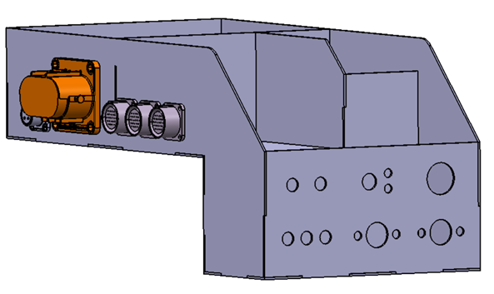
Reset Switch
TSMP

Slide 7
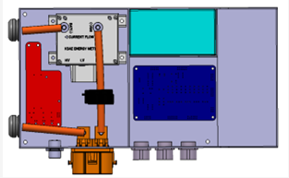
방전회로
TS
GLVS
TS
GLVS

Slide 8
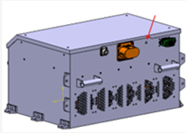
AVI

Slide 9
